Slide 1
Staying Calm in Times of Crisis
Shelle McDermott
Author, Speaker, Prepper
Contact: cimprint@live.com
Notes:
Hello Everyone! Can you believe it? We are on our last session! You have learned a lot! Good for you! Don’t give up! Strive for a life of self-reliance! Strive for becoming the center of the storm! Strive for peace and safety in future events!
You know the old adage, if you fail to plan, you plan to fail. So…give yourself a big pat on the back! You are in the top 10% of society who is planning to succeed!
Better than that, you are becoming a conduit for the Savior. You will be able to help others, teach them, and introduce them to the Savior’s love and mercy.

Slide 2
Introduction Session 4
Shelter, Safety and Camp Life
Notes:
Today we are going to discuss Shelter, Safety, and Camp Life for a long term crisis. Some of the ideas will be repeated from other sessions, but with a little more depth.
Many of us will be able to “shelter in place” during a crisis, but the odds are getting greater and greater that we may be displaced from our homes long term.
May I suggest that you look for groups that are like minded and weather the storm together! It will be necessary for your very survival. Those who remain a stand alone survivalist will be an easy target for roving gangs. The stress of surviving will overcome a smaller unit much quicker than a larger group where responsibilities can be shared. Please consider prepping with like minded and meeting up with like minded when the time comes.
Please consider multiple “Plan B” places. Extended family? A campground? A family cabin or mountain plot of land? Do some early surveying of the conditions and be ready to go in an hour’s time as many calamities don’t give you a warning. If possible, have a stash of supplies already stored at your Plan B location.
Here we go!

Slide 3
Leaving Your Home Long Term Violence or complete devastation prevents returning.
Shutting off utilities, water and gas.
Paying taxes.
Things to leave behind.
Notes:
Don’t read.
Let’s do some planning. Let’s say you need to leave your home because of a nuclear blast 20 miles away. You have less than 6 hours to evacuate. What do you do?
You shut things down knowing you probably will not return to your home for several months or years. When you leave, hop on the internet and schedule a turn off date. You can go around your property and shut off water and gas.
Another consideration is that you should store up your heirlooms and save in a storage unit or another family members in another area. Things like family portraits, family antiques, family photos and family history books, personal library, journals, etc. Make a list now of things you would want to remember to remove from your property if you have some time to load them and drop them off.
If it is determined that your home is safe but the area is not inhabitable for awhile, and you are worried about losing your paid for home due to taxes, consider storing up some gold to pay the taxes in advance. Did you know Utah passed a law a few years accepting gold or silver to pay your bills with the state of Utah?

Slide 4
Plan for Pets
Supplies:
Leash
Tie Down
Kennel
Toys
Food
Notes:
Don’t read.
Do you have pets or animals to care for? If you have many consider where they will go. Have adequate supplies for them. If they are going to be with you in a camp setting, make sure you have a leash, a tie down, a kennel, play toys, food, etc., to keep them from becoming a camp nuisance. If pets are not permitted, who can you leave them with? There will be tough decisions in hard times. If you pre-plan it can lessen the stress and trauma.

Slide 5
Dealing with Family & Friends
Master Plan in writing.
Pre-organizing and what to leave behind.
Contact Info
Notes:
Have you ever worked with someone and it was frustrating to know what they were going to do next, what the overall goals were, what was expected from you to be thorough? Don’t be that person.
Put your plans on paper. Give everyone copies. Circle or check off what their responsibility is. If you pre-plan an evacuation it will be easy to type up a list of assignments ahead of time and pre-teach each person what that assignment is and what is expected.
Drop an email to people who know you and explain where you are going and how to contact you. Include neighbors who will not know what to do if they find out your home is vacant.
If you have married children, send them a list of items they would want to pack to join you. There is a “buckets and bins” list on the temporal page of nofearpreps.com. It may be too extensive you can alter it and make it your own!

Slide 6
Suggested “to do’s” for an evacuation – delegate!
Prayer. Remain calm. Keep a level head.
Lock all windows and doors. Shut off water and gas valves on the property. Email utility companies for shut off. Send email to family & friends about your plans.
Store keepsakes and valuables away from the property.
Load the food. Load the mattresses. Load the gear, tools, etc. (Store up tie-downs, lots of them!)
Hook up the trailer or trailers. Fill up vehicles on the way out.
Room to room list for last minute grabs. Tape a list from each room on a bucket or bin and assign a room to gather items.
Notes:
Read

Slide 7
Questions for Pre-Packing
Where are you going?
What clothes, shoes, and gear will you need if stores are no longer available?
What kind of food will you need?
What kind of water considerations should you make?
What kind of sleeping arrangements will you have?
What kind of gardening tools will you need if long term?
What kind of shelter will you need? The smaller the better for heating purposes.
What kind of fuel sources will you need?
Notes:
Read
Most of Session 1 & 2 cover these types of ideas.

Slide 8
Moving and Packing Your Preps
How much do you have?
Trailers, RV’s, Trucks, and more.
Mattresses.
Packing for security and maximum space.
Moisture and Rodents.
Garbage Bags.
Notes:
Read
There is nothing more disappointing than not having enough room to pack what you need to flee.
We bought an extra older 4 wheel drive truck just for hauling a second trailer. We have nearly 30 in our tribe with kids and grandkids who are planning to meet at our home during an emergency.
We have assigned drivers for the RV, the trucks w/trailers, the vehicles with children and mattresses strapped to the tops. If you know you are going away long term, you will want to strap a few mattresses on top of a vehicle to save trailer space. Make sure you have plenty of tie downs stored up for packing needs!
I talked about having hammocks and blow up mattresses, but in cold winter that is not conducive. You will want a mattress or two to take for comfort and warmth in your tent.
If you can, make your packaging uniform, like all buckets and same size bins. You will load easier and you will have more space. Try to pick packing supplies that are moisture proof and rodent proof. We have stored a few boxes of mice bait and insect bait. We work mostly with 5 gallon buckets we can seal. We have most of our food in sealed mylar bags before storing in buckets.
If you don’t have the vehicles to haul, you can simply store all you can in garbage bags. Store up a few boxes of bags for when the time comes. When you pack clothes, gear, shoes and even food in kitchen size garbage bags, you can pack more in your vehicle versus using boxes. Consider looking for a used cheap RV to drive. You can store up a lot in the RV and you can have shelter!

Slide 9
Arriving at Camp – First Things First
Layout considerations.
Bathroom and garbage.
Quiet Areas
Children’s play areas.
Messaging system.
Laundry area.
Animal area.
Food prep and shared firepit area.
Notes:
I talked about this briefly before.
You will want to take into consideration how camp is laid out.
The bathrooms and garbage should be at the outer edge of camp and downwind.
There should be assigned quiet areas and curfew times for quiet times. I have packed ear plugs because no matter how hard you try, there will be babies who cry, dogs that bark, children who squeal, and strange noises in the dark that will keep you from getting good sleep.
Children’s play areas should be in the center to allow for keeping a watchful eye.
Messaging areas (plastic over the door shoe holder for message mailboxes).
Laundry area where people can share resources and keep water from tracking back into your tent or RV.
Animal area, whether pet or livestock.
You can save on wood if campers have a share firepit for cooking. A food prep area can also help with sharing resources and meal prep assignments. Living off grid can be exhausting and all hands are needed.

Slide 10
Medical Triage
Who is skilled with medical knowledge and treatment?
If someone gets hurt, do they know where to go?
Is there a common medical cabinet that can be shared?
Are there medical devices like crutches, boots, wraps that can be shared?
Is there a blood pressure cuff and suture kit available?
Are there essential oil and tinctures available and who can administer them?
Notes:
If you are in a group with many others, it won’t hurt to share resources and knowledge for many things, like medical, gardening areas, clothing exchanges, common tools, communication center (like ham radio, 2 way radios, solar chargers, etc.) Just assign someone to organize and be in charge of the items at their tent.

Slide 11
The First 72 Hours
Add water only food, canned food, ice chest food, etc.
Separate critical items for setting up a tent for quick retrieval.
Have activities for children to be distracted or helping.
Have treats that provide a happy positive environment.
Have group meetings and prayer often. Children handle trauma better than adults.
Have an assignment list to keep everyone engaged and helping.

Slide 12
Living Peaceably with Others in Camp
We cannot control others, but we can control our own reactions. Pray constantly for self restraint.
We can strengthen ourselves spiritually so we can endure injustice.
Making a Master Plan for settling our differences. There needs to be rules and consequences. There needs to be love and patience. There needs to be trust.
Leadership, personal responsibility, and delegating.

Slide 13
How Much Ammo & Guns Do I Need?
How big is your group?
Will there be hunting for food?
Will there be security and protection?
Will there be training and practice for protection?
Will there be a structure or system for authority?
Notes:
Read.
If you have a larger group, you will probably share resources.
If there is hunting (and most likely there will be) there should be a sharing of ammo and a sharing of meat and labor. If you don’t own a gun, at least buy ammo for rifles to hunt and share in the expense of hunting or trade your labor in preparing the meat, etc.,
At least one person in your group needs to be prepared for security and protection. It would be preferable if every family had something, even if it is a stun gun or mace.
Training and practice of firearms should be provided so that even the women and teens know how to load and shoot a gun. Sadly, gangs and marauders are a part of civil unrest. Sometimes bears and cougars are found near camps.
There needs to be an agreed upon hierarchy of power and authority within groups. Is there a quorum for voting? Is there a tie breaker for a final vote? Is there respect among the members and trust? Stress brings out a lot of frustration, anger and disagreement. Find a way to peaceably communicate. Daily prayers together, softer voices, less commanding and more including, more teaching and more communicating to avoid harsh words and hurt feelings. This cannot be stressed enough. You have to have a communication hierarchy or there will be too many chiefs and not enough Indians in camp.

Slide 14
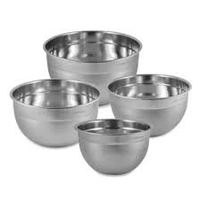
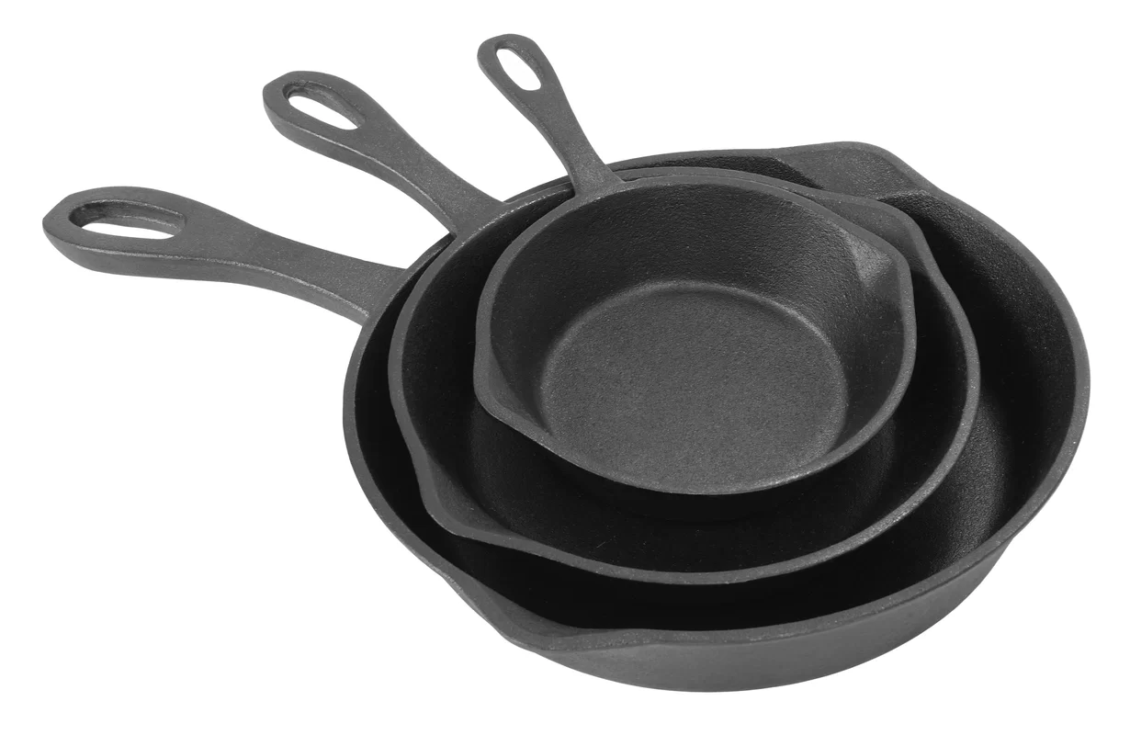
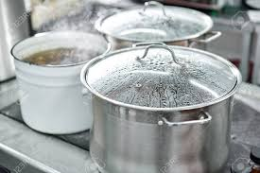
A Review of Different Camp Items to Store
Dishes
Pans
Prep Dishes

Slide 15
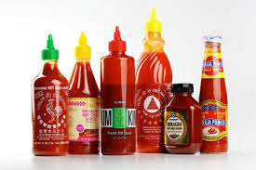
Spice Bucket
Notes:
You can make cardboard taste good with a great variety of spices!
Include your favorites!!
Taco seasoning, Italian Seasoning, Greek Seasoning, Kung Pao Sauces, Duck Sauce, Sweet & Sour Sauce, Mongolian Sauce, Powdered cheese, Carribean Jerk Sauce, Hot Sauce, Lemon Pepper, and of course, Salt & Pepper and Garlic.

Slide 16
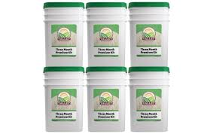
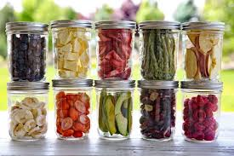
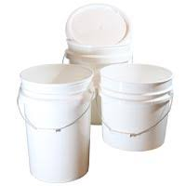
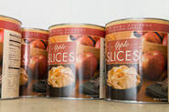
Food Buckets – Long and Short Term!

Slide 17
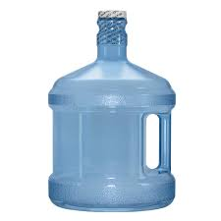
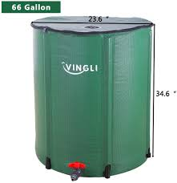
Water Containers
Purifiers
Empty Containers
Cases of Water Bottles
Sports Bottles
5 gallon buckets
Rain water containment barrels
Office coolers
1 gallon containers

Slide 18
Disease Control Bucket (toilet)

Slide 19
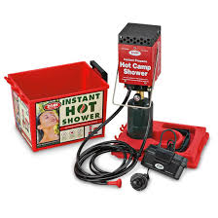
Shower Bucket

Slide 20
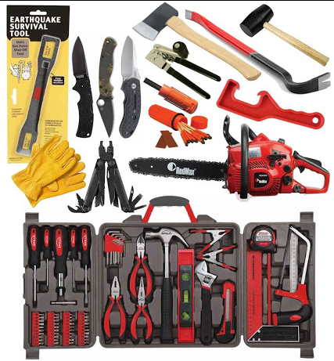
Tool Bucket

Slide 21
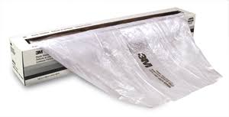
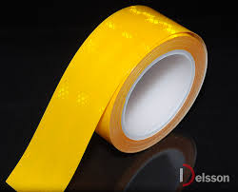
Quarantine Bucket

Slide 22
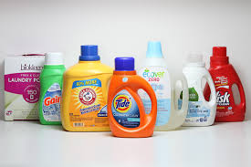
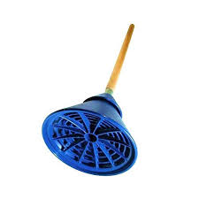
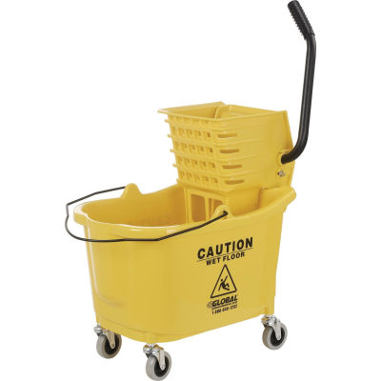
Laundry Bucket

Slide 23
Cleaning Supplies – Stop Disease!

Slide 24
Utility Bucket (MacGyver Bucket)
Notes:
Wire
Paracord,
Glues
Tapes
String
Rubber bands
Fishing line
bungees

Slide 25
Hygiene Bucket (per Person)

Slide 26
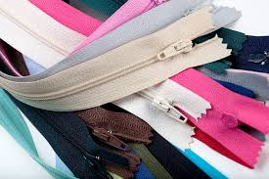
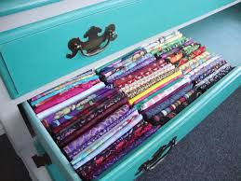
Sewing Bucket

Slide 27
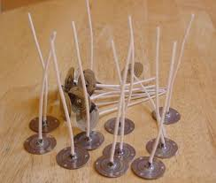
Candle Bucket

Slide 28
Library Bucket
Notes:
How to
Children’s
Science
Boy Scout
Spiritual

Slide 29
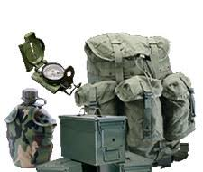
Military Bucket
Notes:
binoculars,
Ammo cans
Backpacks
Compass
Knives
Chargers
Radios

Slide 30
Shoe Bucket
2 tennis shoes
1 hiking boots
1 snow boots
1 galoshes
1 flip flops (showers)
1 sandals
2 dozen socks (winter/summer)

Slide 31
What About Precious Metals?
Dollar Devaluation
Historical Patterns
Benefits of Gold
Benefits of Silver
Other bartering tools
Notes:
These are some tough decisions to make because we are in unprecedented times. Countries around the world are struggling with corrupt leadership, unsurmountable debt, increased calamities and unreliable weather for farmers.
We have patterns from history, but we need to consider new was of thinking to protect our assets and wealth.
Some items to consider:
A Dollar Devaluation is rare, but has been done the past. From the patterns we see in our economic system now, with debt levels in unchartered territory, viruses that flattened the economy, record levels of unemployment and corrupt politicians who are rooting for the collapse of our system in favor of a socialist/communist type system, we can probably look forward to our dollar being devalued in our lifetime with the false sense of security that this would be a good move.
What is a devaluation? It is not a collapse. It is a devaluation. When the dollar is devalued, it makes exports increase because the products are cheaper to buy.
Due to the US’s balance of payments deficits and bloated net external debt to GDP ratio (about 45 percent), the dollar will eventually need to depreciate.
However, it will create a negative to the pension programs that are already needing bailed out and unintended consequences will cause another bubble in the American economy to collapse. This time, with civil unrest on the rise, it may not run a course correction, but rather sink the country into further complications.
Without going into to more details, you can do an internet search to teach you about the ramifications of a dollar devaluation. If you are LDS, the prophet Joseph Smith was recorded as saying, the next great trouble for the United States will be the devaluation of the currency. A term rarely used in our country’s history is now being peppered in the financial trade papers and the federal reserve is currently in the works to make this happen.
What are some planning strategies?
Get out of debt.
Have hard assets.
Own some gold and silver to counter the initial impact.
Removing traditional investing currency and placing it into more gold and silver to ride out the storm.
Gold is good for larger value and it doesn’t take up as much room.
Silver, especially junk silver coins, is good for small bartering and purchasing. You won’t be able to take a gold coin into a grocery store and expect hundreds of dollars in change back, but you might be able to pay your yearly taxes with a gold coin.
Keep in mind that if banks close, society is broken, and people are in basic survival mode, the only thing of value will be food.
If you have the resources now, store up more food than you will need. Store up other valuable bartering items such as tools, fuel, alcohol/chocolate/coffee/cigarettes (any addictive substances that addicts will be willing to barter for), ammunition, car parts, water filters, pain meds/antibiotics, batteries, fishing gear and hygiene products.

Slide 32
Mental and Emotional Strength
Begin with the end in mind.
Getting camp set up to accommodate everyone.
When others are not adequately prepared.
Pulling on strength greater than our own.
Notes:
Read.
We have all heard the term situational awareness. It is when you have been awakened to what is going on around you and you are more in tune with events or behaviors and their meanings. Many of you are going through this now. No matter how much the news media tells you one thing, you know better.
Many of us have the advantage of being older and can compare what life in America used to be like for decades and suddenly it is hardly recognizable, whereas a younger college age person only sees the world from the view that every thing is fine, there is still food in the stores, and their cell phone still makes calls.
It is becoming more and more apparent that traditional values and basic self reliance habits are fading away at a rapid pace. You hear the mantra, “to make room for a new progressive way of life”…However, history has patterns. We know of hundreds of civilizations who have passed away because they adopted progressive thinking and removed the very mores that provided peace, security and wealth.
I’m not dogging the technological advances. We have lived very blessed lives. However, there is opposition in all things. The internet can be used for genealogical research, or mass distribution of porn. We have to be able to discern and set limits. Sadly, you cannot legislate morality. You can only strengthen yourself with self-discipline and teach it to those in your circle of influence. The same theory goes with preparedness for hard times that may come. You can only prepare yourself with a self reliant way of life and encourage others in your circle of influence to do the same.
So…begin with the end in mind. What is your goal to being prepared? Are you going to hunker down in your home until you draw your last breath? Are you going to have a Plan B spot in place in case you need to evacuate? Are you going to learn homesteading skills and store up some essentials or are you going to be at the mercy of others should a calamity strike?
It’s not a pleasant thought to have these conversations with family members, but it is time to “wake up” to our surroundings and the conditions in our government and nation and see the warnings to get prepared. You can do this with simply asking, how can we be prepared if xyz were to happen to us? Write down ideas, delegate assignments to get the preps done, report back with one another. Creating a sense of community, trust, togetherness and dependence on each other. People will handle stress and calamities better if they feel a sense of belonging. Resist scaring people or yourself into prepping. Take calculated and consistent steps to do something everyday or every week. The window of time to be thoroughly prepped is closing.
If you can, store up extra preps. There will be others who are forgot things or who are inadequately prepared. Bring all you can! There may even be others who will join your group with just the shirts on their backs. When you set up camp make a place where people can feel welcomed, loved and accepted. Most survivalist go into “survival of the fittest, or plundering mode” but we are not to do that! Being prepared keeps us from getting involved in the fray and causing us to behave badly when we would have never made those kind of decisions.
When all is said, it only takes one person in the family to organize your resources and continue to prepare. Sometimes we have to go it alone and get things done. You will be blessed for your efforts. You are never alone when you ask for divine help.
Miracles are for the faithful. You can expect them, but you must first do your part and ask for them. Then you just start and the longer you go at it, the more you will see things brought to you just for your circumstances.
The same will go when you are living your new life in a grid down situation. Our ancestors were more adept with living in a non electricity world, but we can give it our best shot. The end goal should be a spiritual one. You are being sanctified. You are being prepared for greater things than the upside down world that exists somewhere else. Refuse to participate in the chaos. Strive to live peacefully and loving as you adapt to your new life. Better days will come!!

Slide 33
Preparedness is the key! You become the calm.
Notes:
Well, our journey together is not coming to an end. We are just getting started! We will see each other again some day, we will look back on these days and recognize how we were being guided to do great things! Although I have not met most of you, I feel an immense love towards you! We are kindred spirits.

